Slide 1

THE DIGITAL IMAGE-PROCESSING FOR PLANT DISEASE DETECTION USING AI.
TEAM MEMBERS
NAME REG.NO
P. Venkata Kishore
A. Sai Pranay
S. Padmashree
G. Pavan Reddy
2010030569
2010030467
2010030508
2010030501
01
/ 24
Guided By: - Dr.Arpitha Gupta

Slide 2

INTRODUCTION.
PROBLEM STATEMENTS.
LITERATURE SURVEY
DATASET
FLOW DIAGRAM
GITHUB COMITS
PRE-PROCESSING CODE
IMPLEMENTATION
RESULT
SELECTED MODEL AND TECHNIQUES.
REFERNCE LINK
CONTENTS

Slide 3
INTRODUCTION
In our everyday life we used to see a lot of plants and flower. But in most case we have no knowledge about that plants. Even we don’t know its name. In that case we choose this idea to research and develop our project. Our developed application recognizes the plant in real time by using mobile camera. This project is an attempt at using the concepts of neural networks to create an image classifier by TensorFlow. Convolutional neural networks are a popular realm of machine learning, and are widely used in image classification. So that we choose this topic to research about image classification by CNN and TensorFlow

Slide 4
Problem Statement
our domain is Computer Vision and sub domain is Image Classification.our problem statement is to detect plant by digital image processing . By this project of plant detection, we can detect which plant it is, what are the requirements, any disease. By clicking a pic of that plant, we can come to know about all the details of that plant. This will be a faster detecting process, so that every person can know easily know about a plant .

Slide 5
Literature Survey
S.NO | TITLE | Author | Published on | Pro’s | Con’s
1 | Image Processing Technique for the Detection of Alberseem Leaves Diseases Based on Soft Computing | Eimad Abdu Abusham | April , 2021 | The SVM-Support Vector Machine Classifier techniques is used in this Prediction accuracy is high and having robust working when training example have error in them. | This techniques Require long training time
2 | A Hybrid Approach for Plant Leaf Disease Detection and Classification Using Digital Image Processing Methods | Anusha Rao , S.B. Kulkarni | October 4, 2020 | It is easy to implement and gives quick result. | Slow learner and fully not robust to the noise data in large training.
3 | Image Processing Methods in Agricultural Observation Systems | Chen Zhang , Li Lin | 13 ,April, 2021 | It will help to sustaining the needs of today world by image processing | It requires good online datasets to get access to it
4 | PLANT LEAF DISEASE IDENTIFICATION USING IMAGE PROCESSING AND SVM, ANN CLASSIFIER METHODS | S.Sivasakthi | May , 2020 | The ANN techniques have Good potential with ability to detect plant leaf disease. | It Require more time
5 | Plant diseases and pests detection based on deep learning | Jun Liu , Xuewei Wang | 24 February 2021 | It is an upcoming method which have good potential | It requires more time to implement

Slide 6

DATASET
DATASETS | CHRACTERISTIC | REFERENCE LINK | TECHNIQUES And Models
PlantVillage | It is a dataset that contains roughly 54,000 plant leaf picture | https://www.kaggle.com/abdallahalidev/plantvillage-dataset | 1.Data Augmentation like:- rotation, scaling, flipping 2. image segmentation.
PlantDoc | This dataset contains the details about plant diseases and different image | https://github.com/pratikkayal/PlantDoc-Dataset | 1.ResnetV2 2.MobileNet
Edible wild plant | This dataset contain 62 edible wild plant Images | https://www.kaggle.com/gverzea/edible-wild-plants | 1.Resnet50 3.CNN Model
Ornamental plants | This dataset contain 500 Images of Flower | https://www.kaggle.com/abdalnassir/ornamental-plants | 1.Image classification 2.Instance segmentation

Slide 7
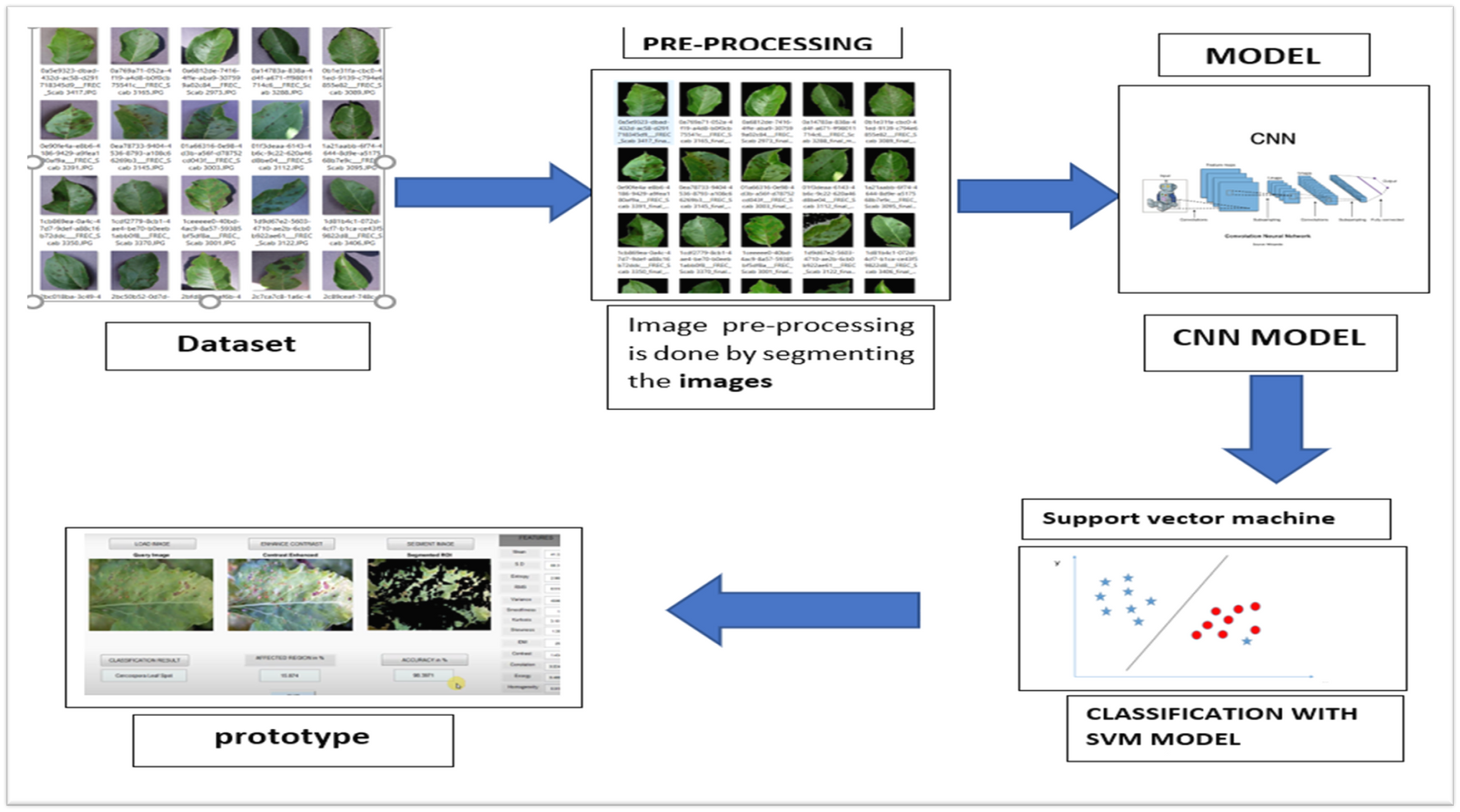
FLOW DIAGRAM

Slide 8

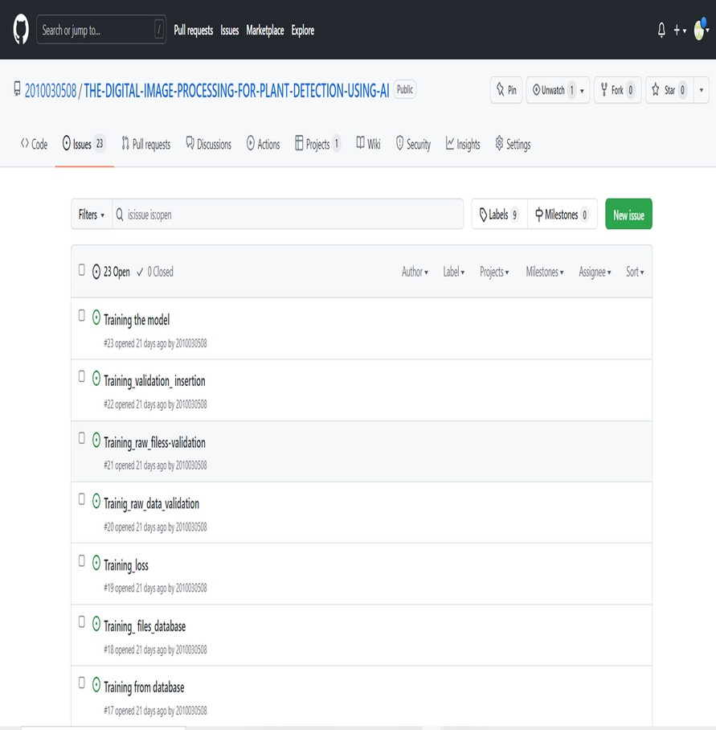
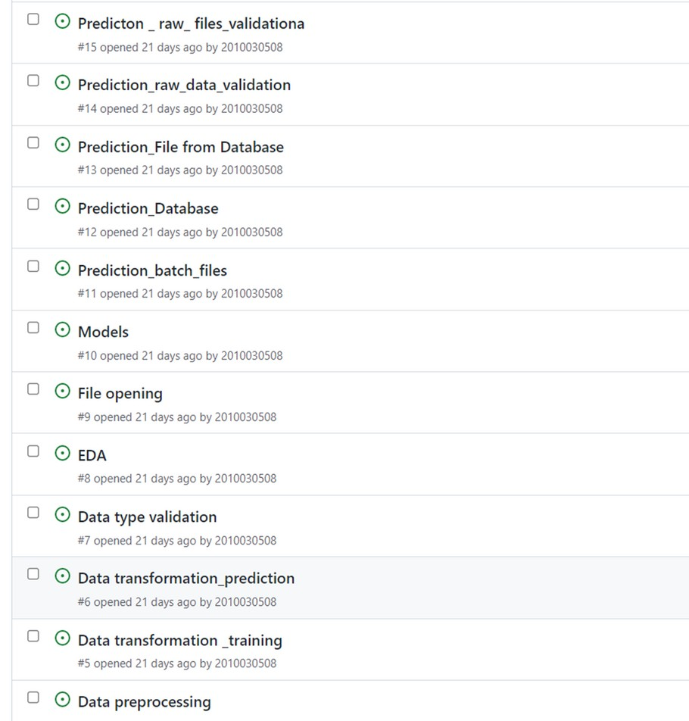

Slide 9

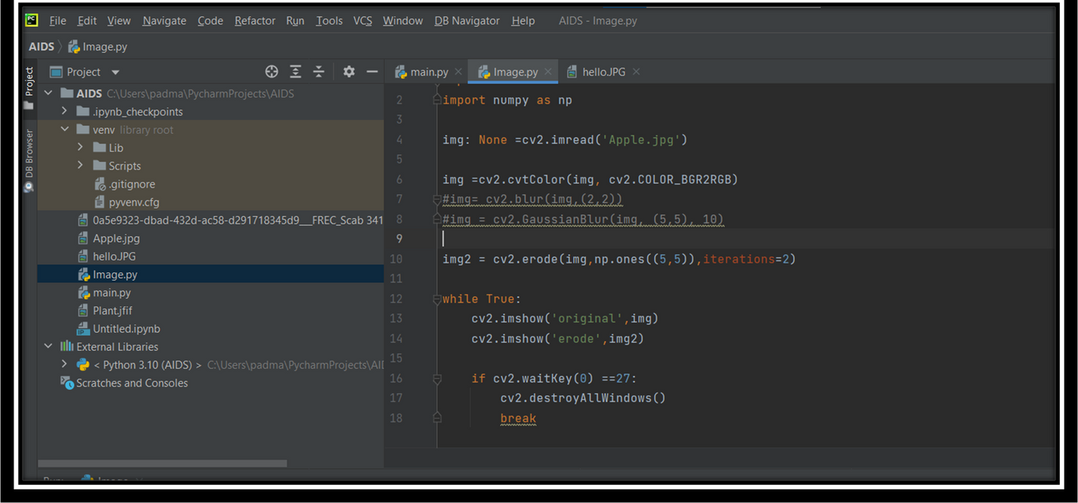

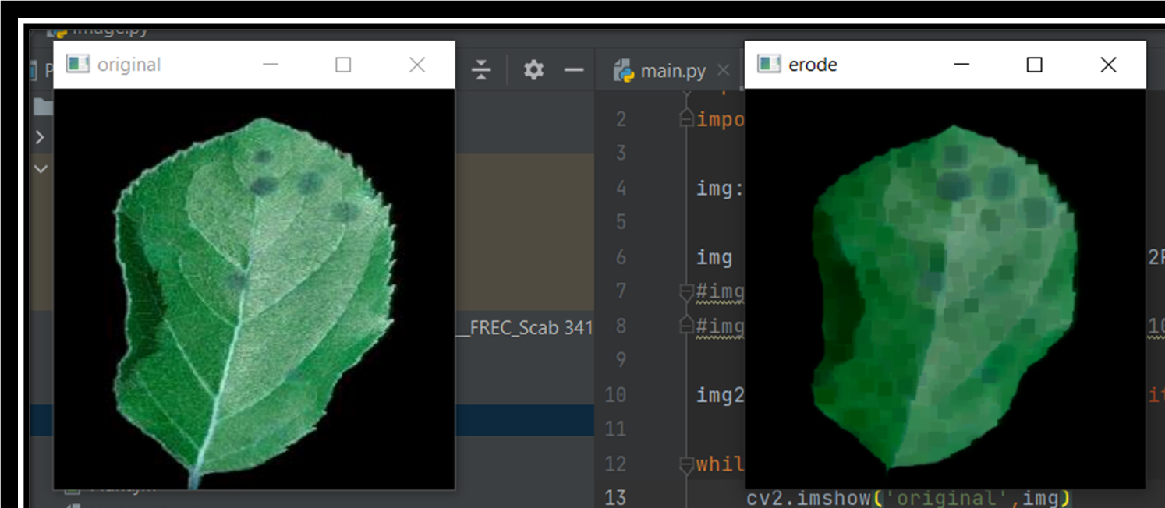


Slide 10
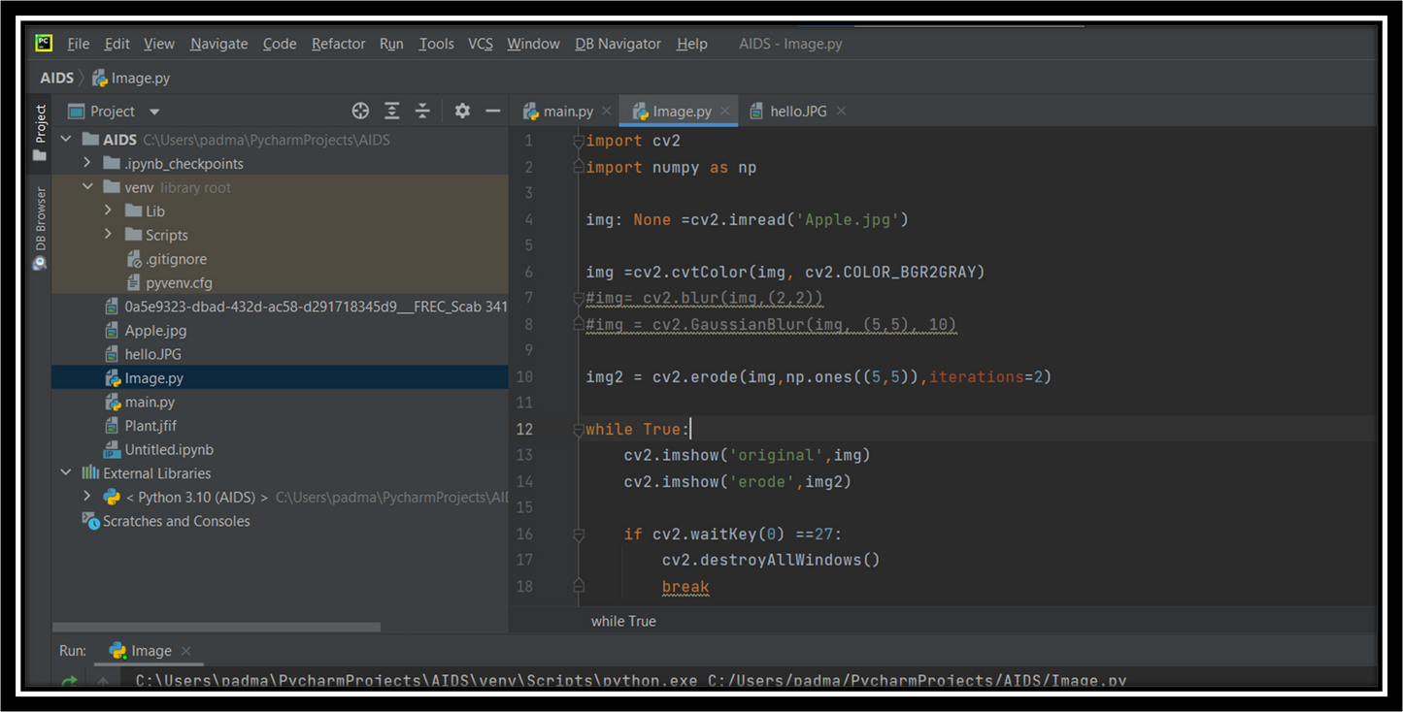

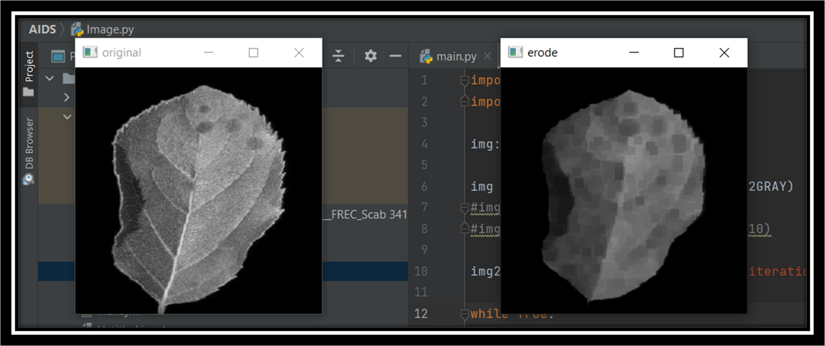


Slide 11
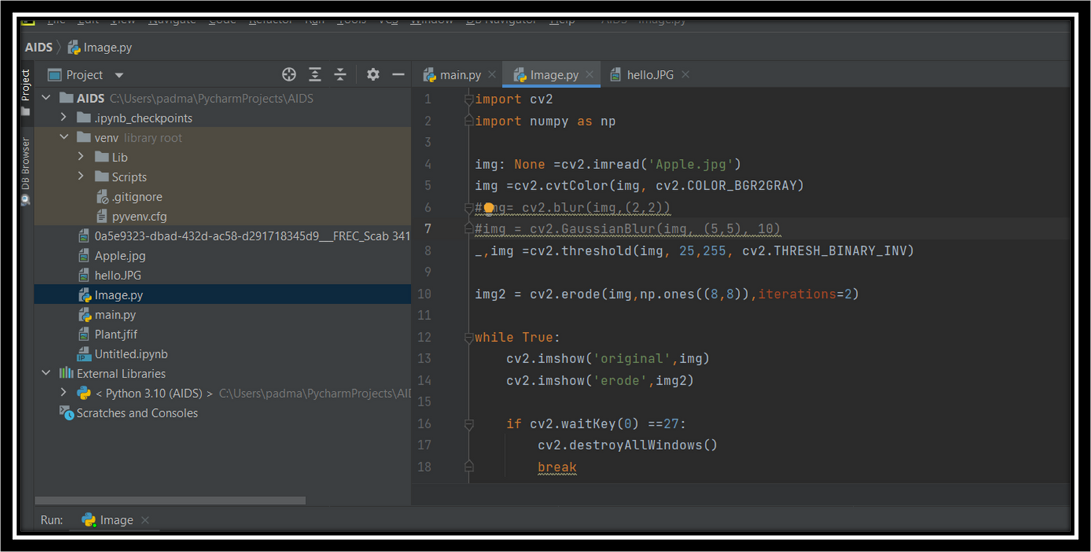

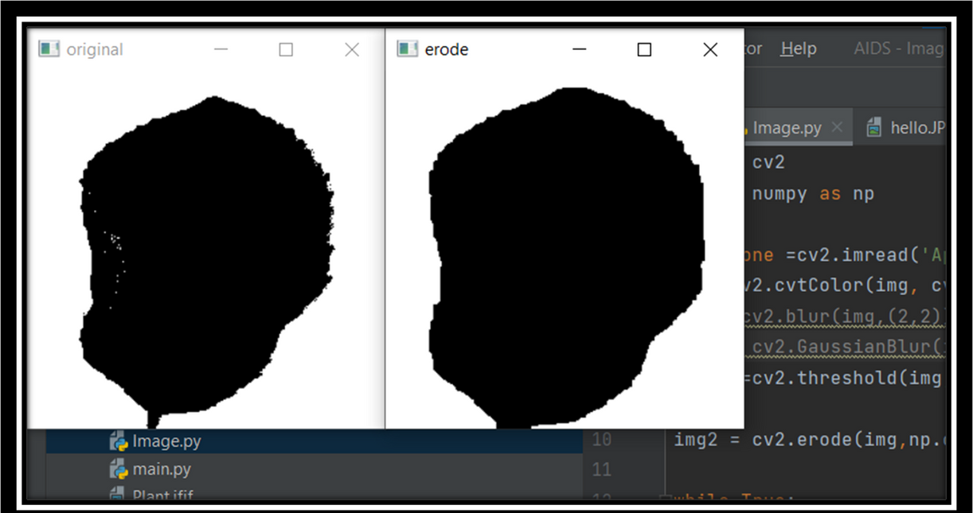


Slide 12
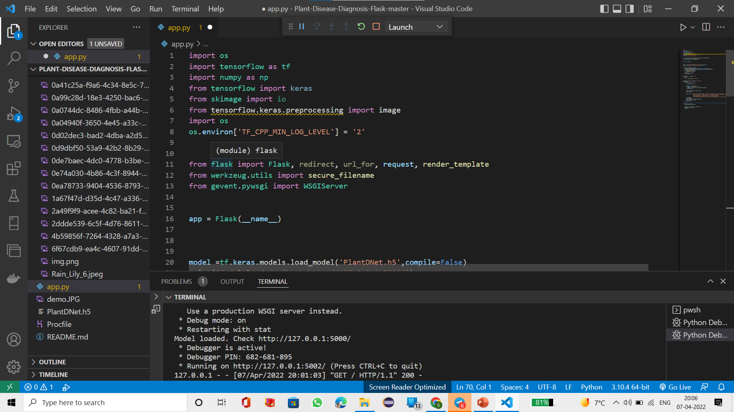
IMPLEMENTATION

Slide 13
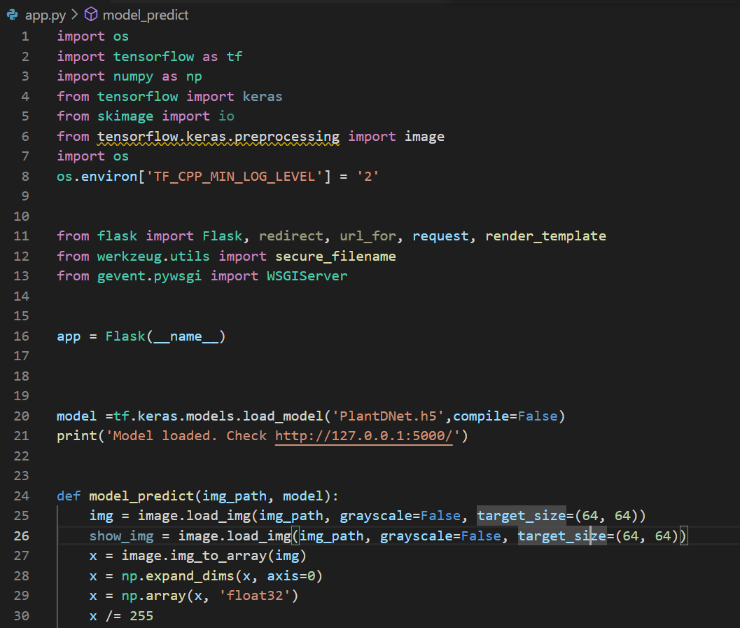
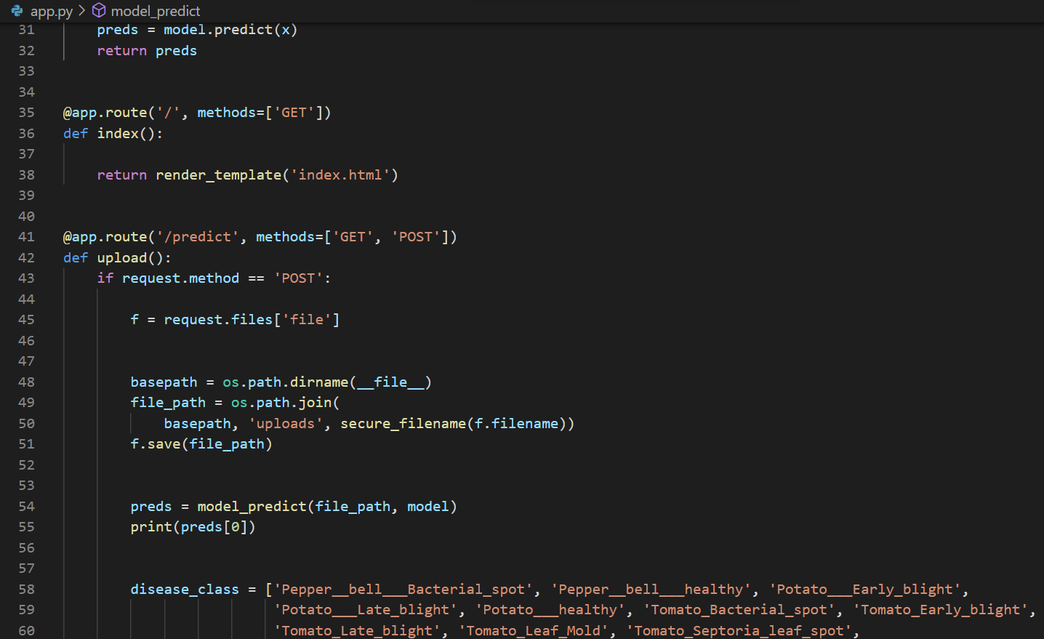

Slide 14
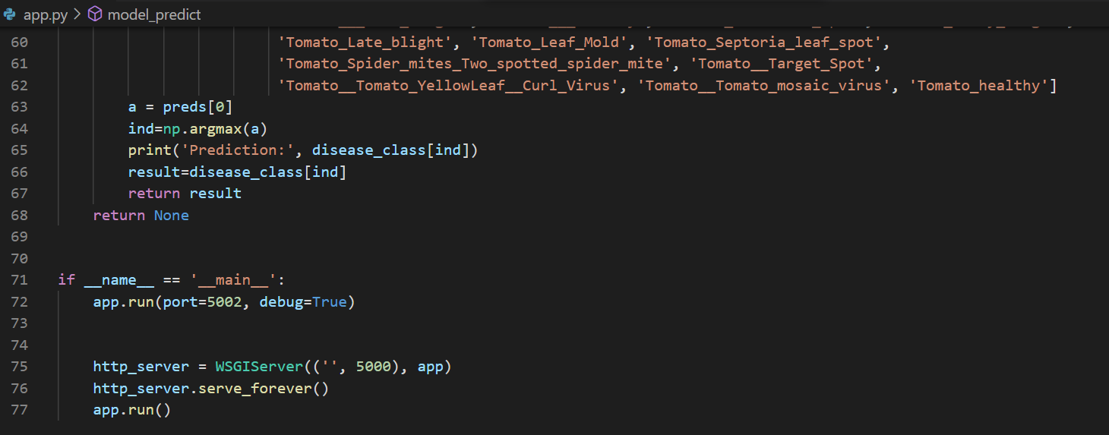

Slide 15
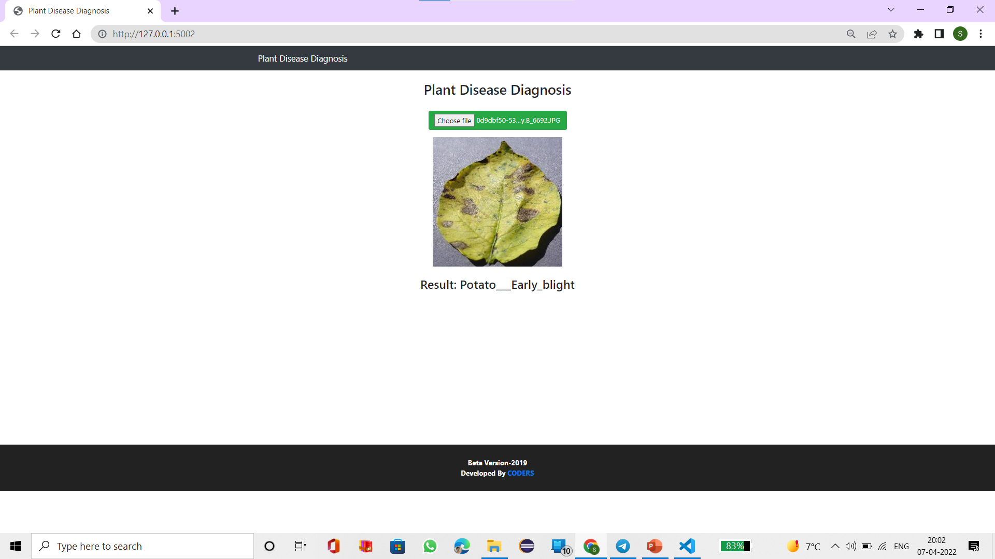
RESULT

Slide 16




Slide 17

